Slide 1
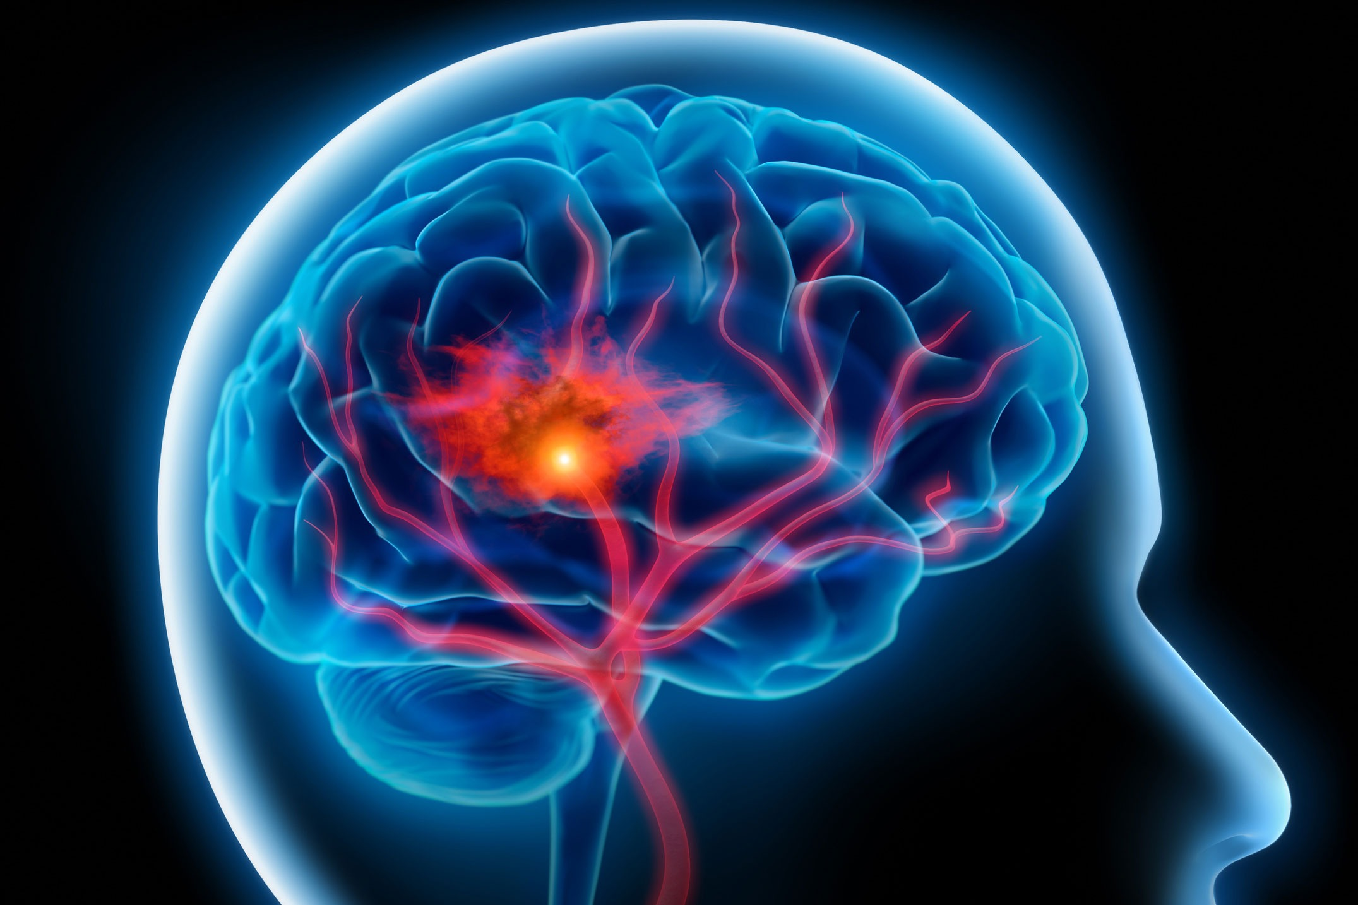
Predicting Stroke Diagnosis with SL
Jaiden Callies (4033) and Alex Hunt (5033)
Proposed Domain:
The dataset used has patient information that can help determine whether a given case is likely to have a stroke.
The algorithms we will use are going to parse data to help accurately determine if an inputted case is likely to have a stroke.
Features of each instance: ID, gender, age, hypertension, heart disease, marriage status, work type, residence type, glucose level, BMI, smoking status, and stroke indicator.
Hypothesis:
With supervised learning, we can accurately predict if a patient is likely to have a stroke.
Significance:
Utilizing SL techniques in this environment could help accurately predict future patient outcomes and increase preventative health measures.
Existing Data:
Dataset from Kaggle: https://www.kaggle.com/datasets/fedesoriano/stroke-prediction-dataset
Proposed Contributions:
Jaiden will implement k-nearest neighbors and naive bayes.
Alex will implement decision trees and random forests.
Total Size: 69 kB
Number of Examples: 5110
Dimension of Instances: 12

